Slide 1

Uber Data Analysis
Rakshita Thawkar
© All rights reserved by Fireblaze Technologies Pvt. Ltd.

Slide 2
Problem Statement
Analysing Uber Data and
Identification of Improvement Areas with Possible Solutions
Studying Trip data to identify specific areas for Improvement.
Identifying root causes for the problems of Cancelled trips and Unavailability of Cars.
Determining the Supply & Demand gap in Uber.
Analysing possible reasons for the Supply & Demand gap.
© All rights reserved by Fireblaze Technologies Pvt. Ltd.

Slide 3

Proposed Solution
Using Pie-Chart to Recognise Supply & Demand gap
Finding Types of Requests (Airport or City) and Recognizing Gaps During the 24-hour Time
Establishing Possible Reasons and Suggesting Various Ways to Improve the Supply & Demand Gap
© All rights reserved by Fireblaze Technologies Pvt. Ltd.

Slide 4
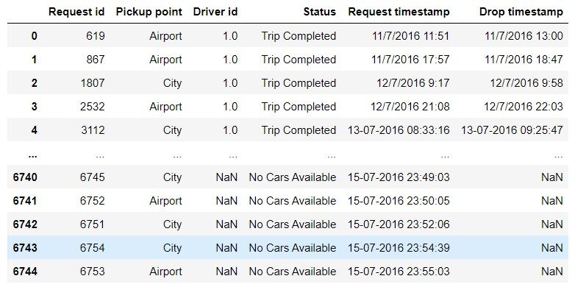
Data Pre-Processing
The Data Set Contained Six Columns:
Request_ID
Pickup_Point
Driver_Id
Status
Request_Timestamp
Drop_Timestamp
Renamed Columns. (For Clarity)
Converted Timestamp Datatype to Object.
Converted Hours Column to List Format.
Converted Hour From the Timestamp to Plot Time Slots.
© All rights reserved by Fireblaze Technologies Pvt. Ltd.

Slide 5
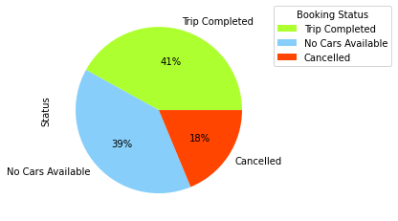
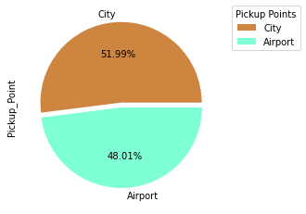
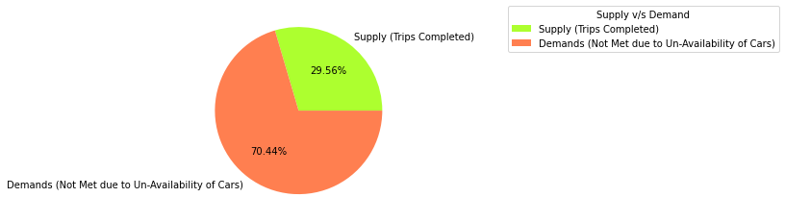
Descriptive Analysis: Supply & Demand
Pie-chart clearly shows that uber is losing considerable amount of rides due to shortage posed by unavailability of cars.
It is evident that under uber, types of ride requests, namely city and airport are almost equal.
Demand & supply are market forces that determine prices and should be met accordingly.
© All rights reserved by Fireblaze Technologies Pvt. Ltd.

Slide 6
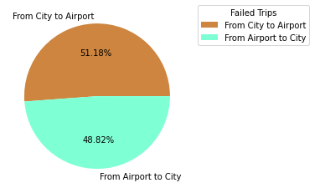
Preliminary Analysis: Recognising Gaps
(Failed Trips = Cars Unavailability + Cancelled Trips)
Correspond equally from Both Airport & City Request Locations
Airport:
Trips from airport are cancelled primarily due to availability of fair-priced airport cabs at arrival.
Cars may be unavailable at airport due to strict competition within the defined airport premises boundary.
City:
Trips within the city usually get cancelled as drivers prefer the nearest passenger booking.
Cars are unavailable at specific locations due to the less frequent movement of passengers.
© All rights reserved by Fireblaze Technologies Pvt. Ltd.

Slide 7
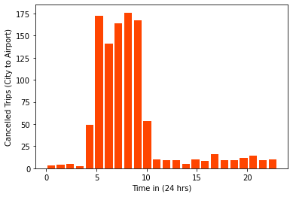
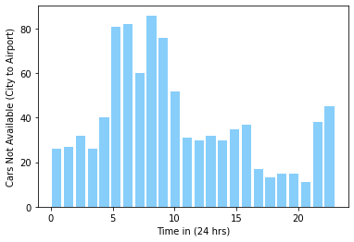
Descriptive Analysis: Establishing Possible Reasons (City)
Time of Cancelled Trips
(Majority Between 4:00 am to 9:00 am)
Working hours usually start late, for some partner drivers since they have family obligations before leaving for work.
`
Peak Time of Unavailability of Cars
(Majority Between 5:00 am to 10:00 am)
The supply by partner-drivers is in no way sufficient to meet the passenger demands.
© All rights reserved by Fireblaze Technologies Pvt. Ltd.

Slide 8
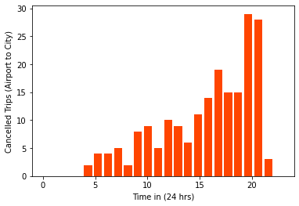
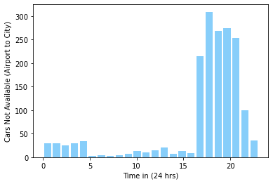
Descriptive Analysis: Establishing Possible Reasons (Airport)
Time of Cancelled Trips
(Majority Between 7:00 pm to 9:00 pm)
High demand from city leads to high wait time for cars at the airport that results in the cancellation of trips.
Time of Unavailable Cars
(Majority Between 5:00 pm to 9:00 pm)
This is the time where majority of the cars are unavailable from airport premises. (Around this time most of the passengers use cabs in the city to return home from work and to visit leisure places)
© All rights reserved by Fireblaze Technologies Pvt. Ltd.

Slide 9
Conclusion: Suggesting ways to Improve the Supply & Demand
Airport (Major Cancellation During Evening):
End of working hours, thus, Uber drivers with families prefer returning home.
The waiting period between arrival and departure of flights is more in the evening hours; thus Uber drivers are reluctant to wait long hours.
City (Major Non-Availability of Cars During Morning):
Working hours usually start late for some Uber drivers since some have family obligations and others have long night shifts.
The supply by Uber drivers is in no way sufficient to meet the passenger demands.
© All rights reserved by Fireblaze Technologies Pvt. Ltd.

Slide 10
Future Scope
An incentive for cab drivers to work at peak demand hours, usually achieved by increasing tariffs for;
City-to-airport during the early morning hours
Airport-to-city during the evening and night hours.
Direct cars from city-to-airport late afternoon to combat the unavailability of cars.
Extra cars in the city to supply high early morning demand.
Consumer surveys to understand cancellation.
Additional:
Uber can incorporate a feature to suggest pooling of privately booked rides for passengers having same or near drop locations.
© All rights reserved by Fireblaze Technologies Pvt. Ltd.

